Slide 1
Continue Exploring
Phenomena

Slide 2
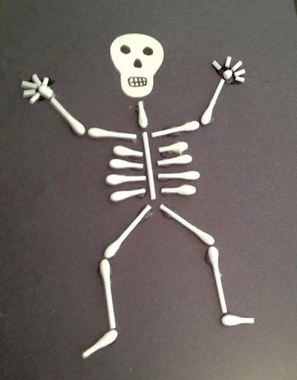
Our Skeleton Project
A Trigger that makes people feel shocked.
https://github.com/GNSPhenomena/SkeletonProject

Slide 3
What Do You Think?
What parts work well?
What parts can we do better next time?
Christmas Project…

Slide 4
if (…){…} else {…} Statement
An if statement can be followed by an optional else statement, which executes when the Boolean expression is false.
If ( condition ) // true or false
{
// statement
}
else
{
// statement
}

Slide 5
if (…){…} else {…} Statement
If the Boolean expression evaluates to true, then the if block will be executed, otherwise, the else block will be executed.
C programming language assumes any non-zero and non-null values as true, and if it is either zero or null, then it is assumed as false value.

Slide 6
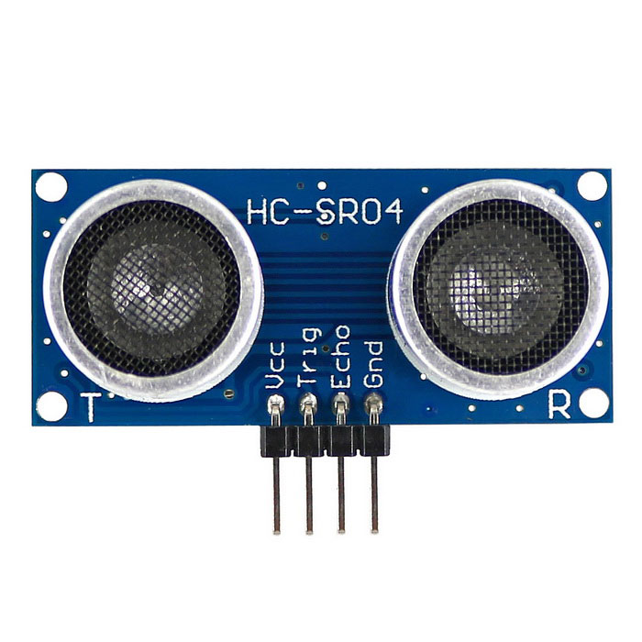
Print Distance on Your Screen
Ultrasonic Sensor
VCC => Power Supply
Trig and Echo => To send out a "Ping". As soon as the TRIG pin goes HIGH then LOW (for a period of not less than 10 µs) the internal clocks start ticking. 8 cycles of 40KHz audio are sent out of the transmitter and it starts counting how long it takes for the echo to arrive.
Gnd => Ground. In digital electronics, negative voltages are seldom present, and the ground nearly always is the most negative voltage level. In analog electronics the ground can be a voltage level between the most positive and most negative voltage level.

Slide 7
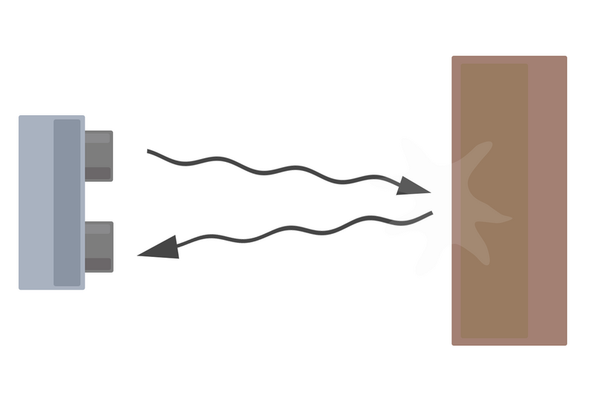
How Does It Work?
Distance = (speed of sound * time taken) /2

Slide 8
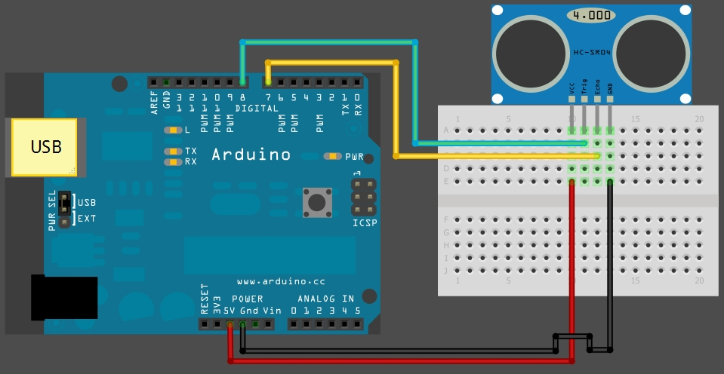
Connect Ultrasonic Sensor

Slide 9
Serial Class
https://www.arduino.cc/reference/en/language/functions/communication/serial/
It is used for communication between the Arduino board and a computer or other devices.
Serial.begin(9600); // opens serial port, sets data rate to 9600 bps.
https://www.arduino.cc/en/Serial/Begin
Serial.print( variable ); // print variable.

Slide 10
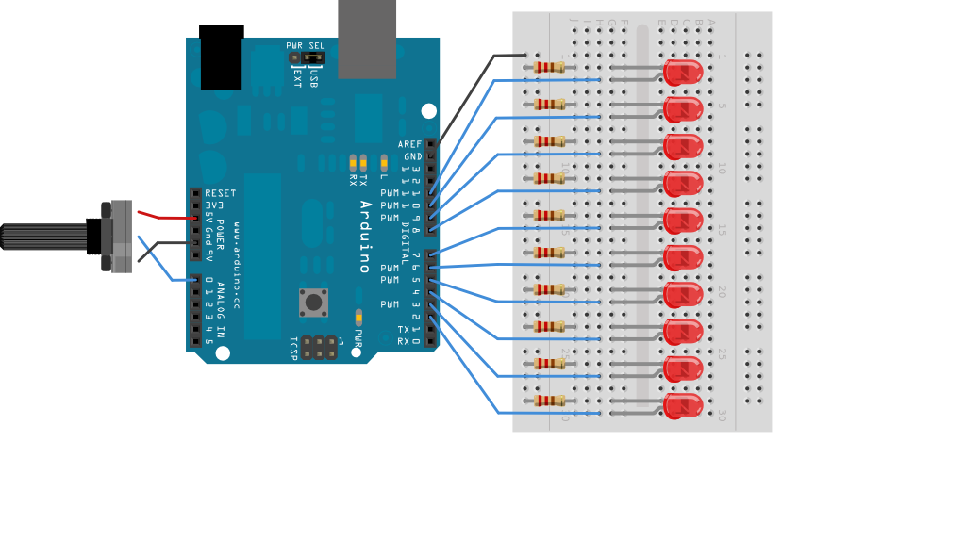
Add Leds to the Circuit

Slide 11
Write a Program
Write a program that makes LEDs shine relative to the distance
Hint: if (…) {…} else {…}

Slide 12
Challenge
Write a distance function
Write a function name: distance
Make it returns the value of distance

Slide 13
Great Work
Have a Wonderful Week!

